Slide 1

Robot Cell Safety 101 Training (Module 36225)
Updated 11-17-16
Notes:
Before starting the class, have the following materials on hand: 1) Emergency Exit Plan – Communicate this to Associates.
2) Plan and map of which robot cell you will tour
2) Class Roster
3) Printed Tests
Give an introduction to the class on Robotic Safety 101. Ask for introductions from everyone and conduct an ice breaker exercise.

Slide 2
Robot Cell Training Hierarchy
Robot Cell Safety 101 Training course is a prerequisite for any robot cell specific process training. This training alone does not permit any users from actively interacting with a Robot Cell.
Training Title | Who is it for?
Safety School Awareness / Standup | All Site Personnel
Robot Cell Safety 101 Training | All Associates, Managers, and Maintenance Personnel that will interact with any Robot Cell.
Robot Cell Specific Classroom Training | All Associates that have job functions with a specific Robot cell.
Robot Cell Specific Operator PMVs | Operator Level A: Associates who frequently interact with the Robot cell.
Advanced Operator PMVs and Exceptions | Operator Level B: Problem Solver, Exception Handling, Advanced Operational Tasks.

Slide 3
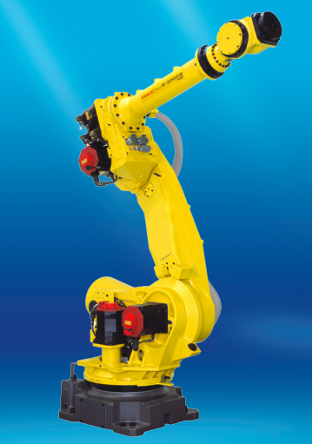
What are Robots?
Robot - Manipulator and controller
Robot System - Manipulator, end of arm tooling, auxiliary axes, other equipment controlled by the robot, etc.
Notes:
Explain that robots include the manipulator itself plus end of arm tools.

Slide 4
What Are Some Benefits of Robots?
Robots make our processes safer, faster, and more efficient for our associates.
Robots increase productivity
Robots allows us to better serve our Customers
Notes:
Emphasize that robots are helping us grow and meet our customers needs, AND helping associates do their jobs better.

Slide 5
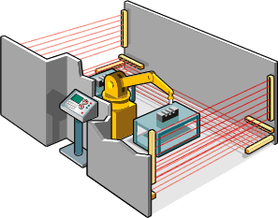
What is a Robot Cell?
Equipment that includes the robot(s) (hardware and software) consisting of the manipulator power supply and control system; the end-effector(s); and any other associated machinery and equipment within the safeguarded space.
Notes:
Every work cell type is unique and distinct. Before working on any robot cell, you will receive additional detailed training on that specific robot cell layout and devices.

Slide 6
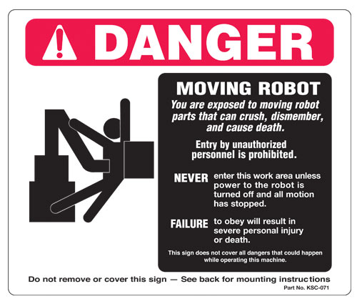
Robot Cells Can Be Hazardous
If any safeguards are deactivate, missing, or inoperable, or the equipment is improperly used it can result in severe personal injury or even death!
Notes:
Explain:
Robot motion can present serious crush hazards which may cause dismemberment or death.
As a result we ensure that all Robot motion is restricted within a defined work envelope.
We limit access to this work envelope by using a perimeter fence or by using safeguarding devices such as light curtains or area scanners which will stop all robot motion when an operator approaches the robot.

Slide 7
How does Amazon keep our Robot Cells safe?
Guards for all pinch points and rotating equipment hazards
Always keep body parts clear of the guarded pinch points and rotating equipment.
Interlock doors and light curtains to prevent unauthorized robot cell entry
Notes:
Robot cells may comprise of additional equipment such as conveyors.
Refer to right picture: Where such equipment exist, all hazards (In running nip points, entanglement hazards) are protected by additional fixed safeguarding.
Refer to left picture: In the event where a large opening may be required to allow for product to move into the robot cell, additional safeguarding devices such as light curtains are used to detect human entry into the restricted robot work space. In this example, light curtains detect human entry but are muted when a pallet goes through.

Slide 8
Robot Cell Entry
Required for entry:
Certified training
AND
Current certification badge
Notes:
No one is allowed in any Robot cell unless they have received proper, certified training on the specific Robot cell. Within a Robot cell, the Robot arm has the ability to move throughout the overall area.
Explain that everyone trained to work on a robot cell will receive a badge stating their training completion date and level of training. The associate must have that badge in their pocession in order to use the machine. An associate must be trained on the specific robot work cell to interact with it. This training alone does not permit an associate from working on all robots.

Slide 9
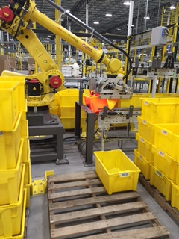
Robot Cell Malfunction
Call for assistance!
Do not enter the restricted access or work area of a robot cell for any reason unless you have been trained on safe entrance procedures or are following proper Safety LOTO procedures.
Notes:
The picture on the right shows a tote that was crushed by the robot. This is a scenario where Operations would contact Maintenance to recover the robot cell.

Slide 10
Robot Cell State
Always assume that a robot cell is operating
Robot cell specific training will define how to identify what state a cell is in (i.e. audible, andon, etc.)

Slide 11
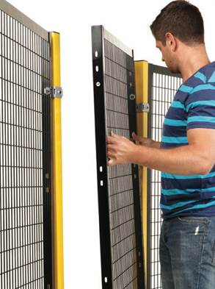
Guards, Curtains, Interlocks
Never tamper with or remove guards, block the light curtain, or override any interlocks.
Installed for your protection and for those people around you.
Should a guard become detached, perform a controlled stop and notify a Manager immediately.
DO NOT attempt to replace a guard yourself.
Notes:
Ask an associate to read the slide.
Reinforce that safety features are in place in order to protect employees.

Slide 12
Read and Obey Posted Signs
Notes:
Always read and obey posted signs.
Signs are located on the fencing and machines to warn you of potential hazards.
Explain that each sign will have a title (“Danger” or “Notice”) to indicate the severity level of the hazard being displayed.

Slide 13
Dress Code Requirements
Follow all Dress Code requirements when working around the Robot Cell
Never wear dangling jewelry
Shorten/Tie-Up loose long hair, or other material that can pull you into a pinch point
Always wear required Personal Protective Equipment (PPE) specific to the robot cell (defined in Robot cell’s specific training)
Always wear break-away badge holders near the Robot cell
Notes:
Explain the building’s PPE requirements for gloves, vests, etc.

Slide 14

Conveyance Safety
Never stand, ride, lean, climb or crawl on or under powered or non‐powered Robot or conveyance.
Notes:
Reminder: Only Associates who have received Authorized training are permitted to work with the Robot Cell .
Ask the scenario: If an item falls under conveyance, are you allowed to crawl underneath the conveyor to retrieve it? Answer: No.

Slide 15
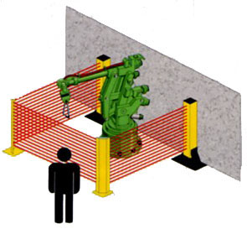
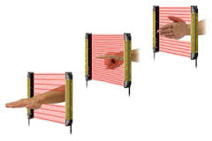
What is a Light Curtain?
Certified Safety Device that creates an invisible barrier around a Robot’s work area.
Breaking the light curtain will bring the robot cell to an immediate stop (E-stop).
Notes:
Explain that light curtains can be used in multiple applications, small or large.

Slide 16
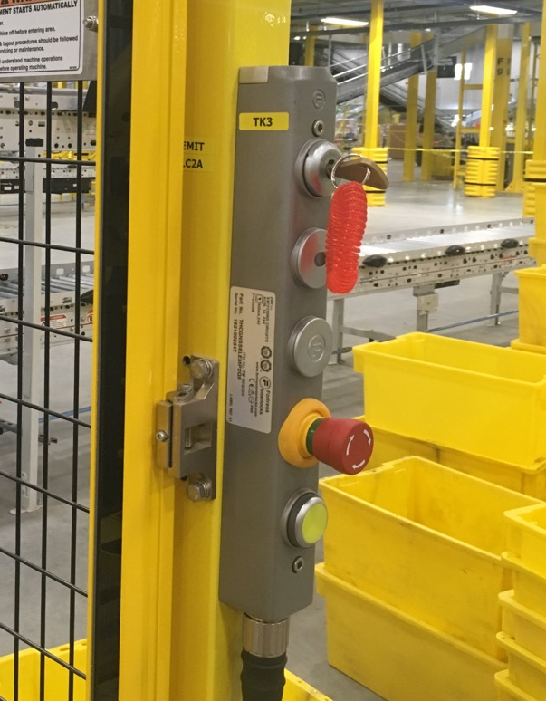
What is an Interlock Key?
Also called Trapped key interlocking
Prevents the restart of the system/access area when someone enters with the key
Ensures safe access to potentially live or dangerous equipment
Note: key cannot be removed unless access to the area has been granted
Notes:
If a work cell has an interlock key, the key must be in the possession of the operator if he/she wants to enter the cell at any time.
Keys are unique to each robot cell and lock.

Slide 17
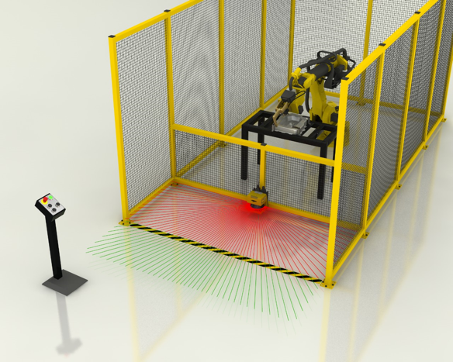
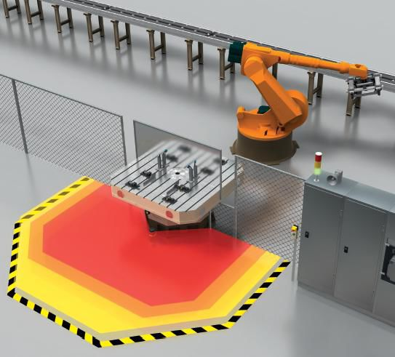
What is an Area Scanner?
An Area Scanner regulates the area of a robot by detecting a presence (human or otherwise) in certain zones.
Notes:
typically area scanners are programmed into 2 zones – Warning (robot slows down) and a STOP zone
Reinforce: In the picture on the Right, the area scanner has three separate zones that could be programmed to have the robot move at different speeds. For example, the robot could move at 100% speed if no one is inside the zone at all. If somebody enters the yellow zone, the robot could slow to 75%. If somebody enters the orange zone, the robot could slow to 50%. And if the robot entered the red zone, it could emergency stop. This is an example. If your work cell has area scanners, you will learn about them in that robots specific training module.

Slide 18
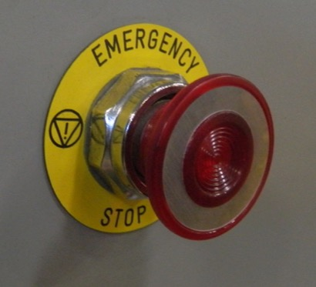
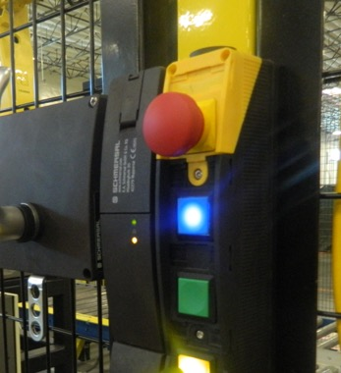
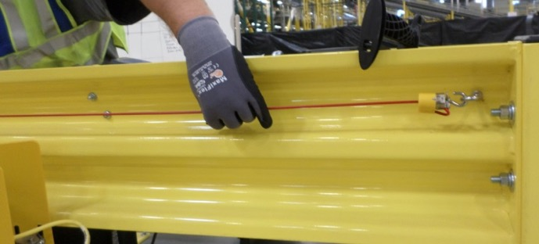
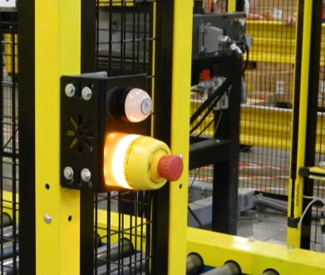
Emergency Stop (E-Stop)
Activation of an E-Stop abruptly stops robot cell
Notes:
E-stop locations and configurations vary by robot cell and site.
E-stops are identified by a Red mushroom shaped button with a Yellow background.
E-stops can also be in the form of pull cords, typically identified by a red cord running along the length of the equipment.
Emergency Stops are located in several places on all Robot Cells, including the conveyance.
An Emergency Stop immediately stops the work cell without regard to product, machine timing, machine position, or relationship with near-by equipment.
An emergency stop should only be used when continued operation is perceived to harm personnel or cause damage to equipment.
In many cases energy is not fully removed from equipment after an Emergency Stop. Some equipment may store or maintain energy in electrical, pneumatic, hydraulic and mechanical systems in order to maintain current position to prevent harm or damage.

Slide 19
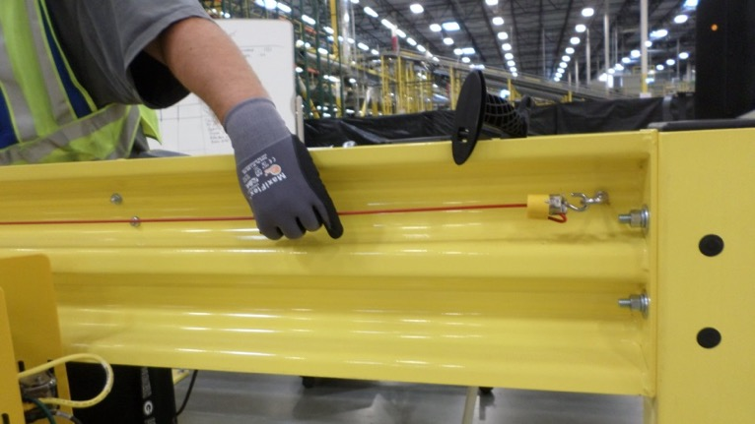
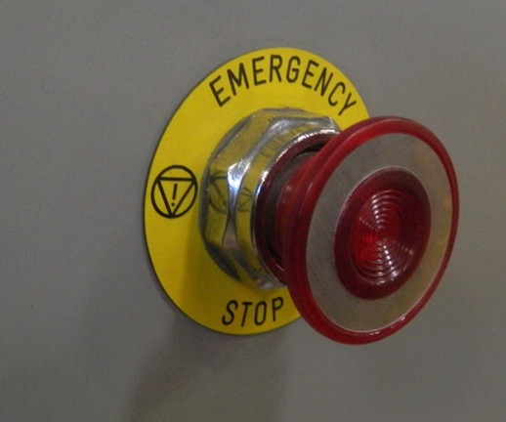
When to Use an E-Stop
If there is a risk of harm to personnel
If risk of damage to equipment
Notes:
Reinforce:
Only press an emergency stop:
If risk of harm to personnel.
If risk of damage to equipment.
Do not press an emergency stop for routine stopping of equipment.
Scenario: “When do you not pull an emergency stop?” Answers: On next slide

Slide 20
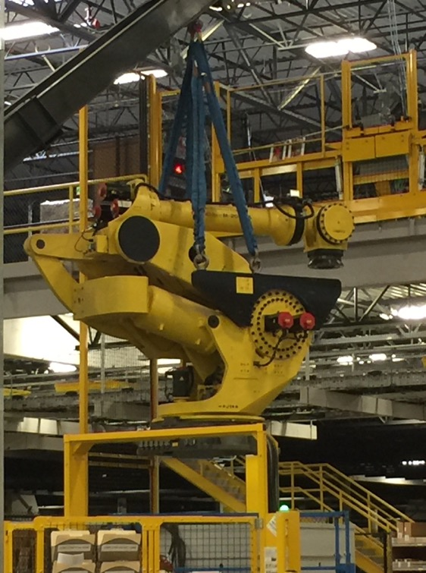
When to NOT use an E-Stop
DO NOT USE AN E-STOP:
For routine stopping of equipment
During an Emergency Alarm Alert (Fire Alarm)
Stopping Equipment Operation
Routine stopping of equipment should be done using a controlled stop.
Picture shown is of the replacement of RoboStow at BFI3 on November 8th 2016, replaced due to over excessive use of E-Stop for the purpose of a controlled stop.
Notes:
Do not use an emergency stop button for routine stopping of equipment.
Routine stopping of equipment should be done using a controlled, or cycle, stop.
Controlled stops allow equipment to continue operation so that any production processes that may be sensitive to time, temperature, pressure or position are allowed to complete before motion stops.
Industrial Robots used within Robot Cells have a lot of momentum during movements. Sudden stops through use of an E-Stop can destabilize or spill loads and, over time, will prematurely wear the robot cell’s complex systems.
The coordinated stopping of equipment in this manner minimizes long-term equipment ware or unneeded expensive damages. (Picture shown are of the replacement of RoboStow at BFI3 on November 8th 2016, replaced due to over excessive use of E-Stop for the purpose of a controlled stop)

Slide 21
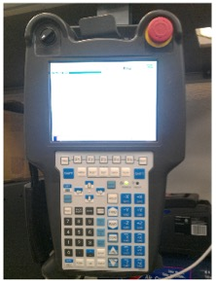
Teach Pendant
Operations Associate Use: Operators can only use the Teach Pendant if it is the primary interface for robot Start and Stop functions. Must be trained and Qualified to perform any task with Pendant. Note: Operations should never use the Teach Pendant for manual movements of the robot or any other task not specifically trained. | Maintenance Use: Maintenance use of Teach Pendant must be trained and qualified. Teach Pendant can be used for manual movement of the robot, programming, control of EoAT (End-of-Arm-Tool), and various other actions. Note: Use of Teach Pendant without training and qualification is prohibited.
Notes:
Say: Teach pendants vary based on the robot manufacturer. A typical Teach pendant is shown.
Reinforce: A teach pendant is typically used by qualified Engineers, Maintenance Personnel, and Subject Matter Experts to program or manually control the robot. In some cases, operations will use the teach pendant to perform basic operations such as Starting and Stopping the robot.

Slide 22
Injury or Disciplinary Action May Result From:
Entering the Robot Cell without authorized training.
Lock-Out / Tag-Out (LOTO) or Alternative Protection Procedures (APP) are required prior to performing maintenance on the robot cell.
Tampering with or removing guards.
Not following posted signage.
Not following proper Dress Code Requirements.

Slide 23

Tell Your Manager Immediately:
Unsafe conditions with the robot cell such as dropped pallets or erratic movements.
E-Stop is not working properly.
Missing or detached safety guarding.
If you notice unsafe behavior by someone else, please take action and notify person of their safety risk.
Notes:
Reinforce: If an emergency stop button is not working, before leaving the robot cell ensure the robot is stopped and if possible press a different emergency stop button

Slide 24
Robot Cell Safety 101 Training
Hand out the paper copy of the Amazon Safety Rules, Policies
& Procedures packet to each Associate
By signing the training roster for this class you are verifying that you have received this Policies packet
Notes:
(Read Slide)

Slide 25
Change log:
Slide#15 - "as shown in red below" - this can be confused for Red 5S tape. Can we clarify?
Action: removed “(displayed below with red lines)” from slide text.
Slide#21 - Include image of ABB Teach Pendant
Action: added “Say: Teach pendants vary based on the robot manufacturer. A typical Teach pendant is shown.” to notes.
Slide 10: Add a note somewhere within the presentation that the operator should always assume that the cell is operating. Never take it for granted that it is ever Stopped. But allow the Robot Specific Training to define how to identify what state it is in (i.e. audible, andon, etc.)
Added slide 10 “Robot Cell State” with this information
Switched slides 4 and 5 for flow.
Slide 6 notes I would communicate ( you can edit as needed)–
Robot motion can present serious crush hazards which may cause dismemberment or death. As a result we ensure that all Robot motion is restricted within a defined work envelope. We limit access to this work envelope by using a perimeter fence or by using safeguarding devices such as light curtains or area scanners which will stop all robot motion when an operator approaches the robot.
Action: notes updated.
Slide 7 notes:
Robot cells may comprise of additional equipment such as conveyors. Where such equipment exist, all hazards (In running nip points, entanglement hazards) are protected by additional fixed safeguarding. In the event where a large opening may be required to allow for product to move into the workcell, additional safeguarding devices such as light curtains are used to detect human entry into the restricted robot work space. ( if required you can have them use the Left picture on the slide as an example..where light curtains detect human entry but are muted when a pallet goes through.
Action: updated notes accordingly
I would continue to keep the focus on the Robot cells vs. general safety where possible. If there is a need to discuss safety in general..I would add a slide to the beginning of the presentation which covers the importance of safety and that this training will focus specifically on Robot work cell safety.
Action: presentation focused on robot cell safety.

